Slide 1
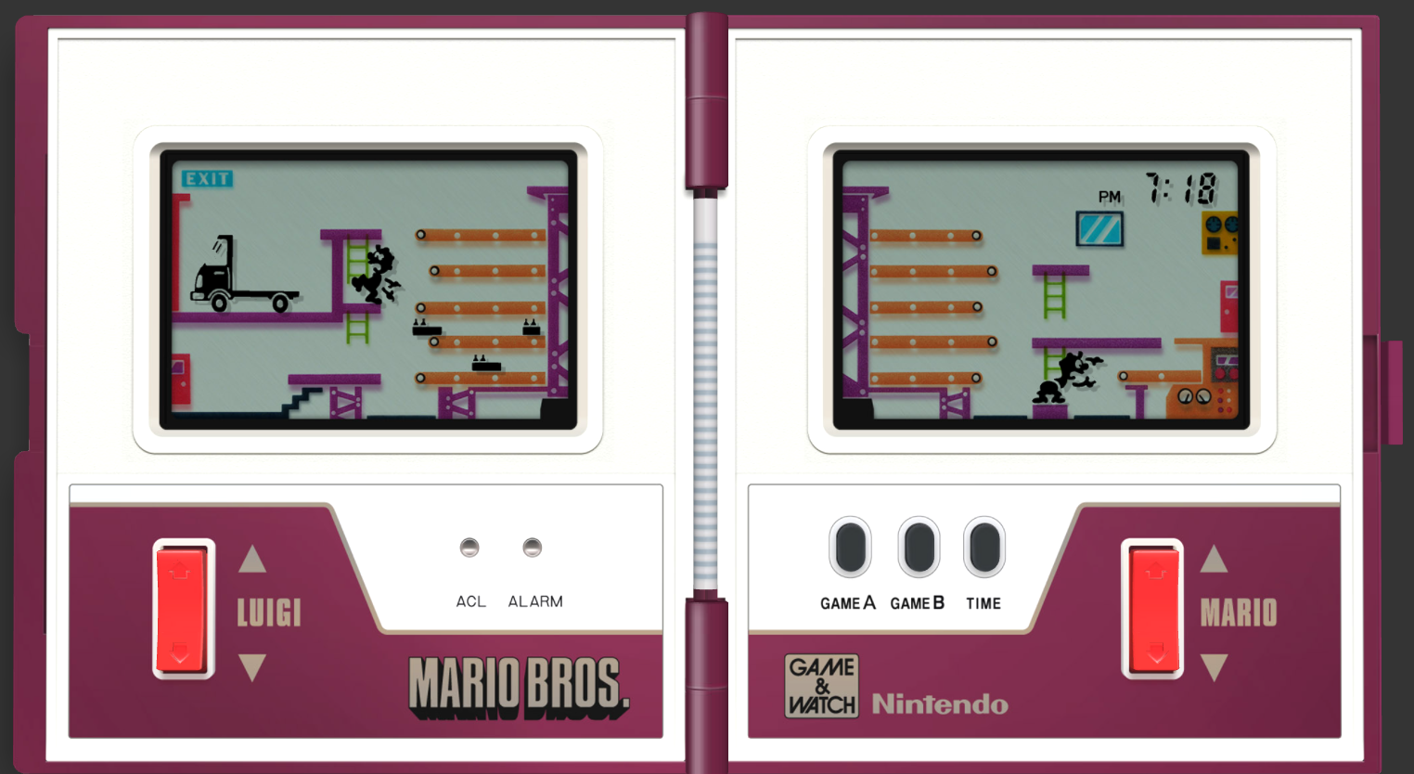
Projecto final
https://itizso.itch.io/nintendo-mario-bros
1

